Slide 1
Transforming Community Mental Health Services; Engagement Slides for Stakeholders

Slide 2
The Community Framework for Adults and Older Adults
The National Collaborating Centre for Mental Health (NCCMH) have developed guidance for a new model for community mental health services – here
The Framework is a radical change towards integrated core community mental health networks – primary care, secondary care and wider community services brought closer together
Networks will be multiagency, multidisciplinary, and include the voluntary and community sector, Local Authority services, social care, primary care etc.
LTP commitment for expanded community teams, delivered around Primary Care Networks on a neighbourhood level, with strong links to more specialist services

Slide 4
NHSE&I Transformation Funding

Slide 5
Transforming Community Mental Health Services within NCL
The aims to be achieved through emerging new models include:
Improving patient experience and outcomes
That people with SMI will have improved access to mental health support and improved care coordination
That care and support delivered will be truly orientated towards the promotion and maximisation of individuals health, wellbeing and independence
That health inequalities often faced by people with SMI will be reduced
That new community models will deliver true integration of care and support across ‘secondary’ MH services, the VCS, primary care, social care, community assets as well as other physical healthcare provision.

Slide 6
Common principles of NCL community models (draft)
NHSE guidance (October 2020):
“Mental health providers are being asked to lead transformation of community mental health services (CMHS) in partnership with PCNs and CCGs, as well as local authorities and the Voluntary, Community and Social Enterprise sector (VCSE), service users, families, carers and communities, to create a new, flexible, proactive model of community-based mental health care for people with moderate to severe mental illnesses across a range of diagnoses and needs, in line with the Community Mental Health Framework for Adults & Older Adults.”
New NCL models must:
Remove the barriers that service users currently experience between primary and secondary care – including to improve physical health care for people with severe mental illnesses – and between different secondary care community teams
Ensure that people can access care, treatment and support at the earliest point of need
Be accessible to all regardless of age, diagnosis, condition, co-existing needs, ethnicity or socio-economic status
Proactively address health inequalities (e.g. SMI physical health, BAME communities)
Address the social determinants of health and wellbeing and overall quality of life including social isolation and issues relating to employment, finances, benefits and housing
Be based on cross-sector collaboration including with local authorities, the voluntary sector, housing and substance misuse services
Include a significant role for the voluntary sector in prevention, recovery and community participation
Provide strengths-based, personalised and co-produced care, with a single care plan
Be co-produced with people with lived experience, as well as carers and local communities
Provide evidence-based and trauma-informed care
Optimise data and information sharing across organisations

Slide 7
What benefits should the new model bring
What it can be like at the moment | What we want it to be like in the new model
Siloed care pathways, with large gaps between secondary mental health services and primary care. | Integrated support across primary-secondary care boundaries to manage fluctuating needs, with flexible ‘stepping up’ / ‘stepping down’ of care based on intensity of input required.
Long waits for access to care, rejected referrals and hand-offs between services. Multiple teams with thresholds and different exclusion criteria: ‘a team for everything but a place for no one’. | Shorter waiting times; removal of arbitrary exclusion criteria; proactive and inclusive care including for co-existing needs (such as substance misuse). Single, coherent integrated model with seamless, clear offer and a named key worker for all.
Lack of responsive, accessible care leading to avoidable crises, admissions and detentions. Particularly, limited support for people with complex or specific mental health needs such as eating disorders or ‘personality disorder’. | A flexible, easily accessible and varied biopsychosocial community-based offer to keep people with SMI well in their own homes and communities. Improved timely access to evidence-based holistic care for specific and complex needs.
CMHTs lacking a clear sense of purpose and identity, expected to do too much with too little | Renewed sense of purpose for community-based services operating in line with the CMH Framework, working in an integrated and multidisciplinary ‘whole system’ with partners across and outside of the NHS to improve the lives of people with severe MH problems

Slide 8
Coordinating model development at a borough and NCL level
OVERARCHING PRINCIPLES
MEASURES OF SUCCESS
MUST-DOs
EVIDENCE BASE (e.g. NICE)
EVALUATION CRITERIA
FUNDING
Centrally determined
Barnet
Enfield
Haringey
Camden
Islington
PCN
PCN
PCN
PCN
PCN
PCN
PCN
PCN
PCN
PCN
PCN
PCN
PCN
Innovation in design and delivery, partnerships, ICP engagement, population needs, community assets
Locally determined
PCN
PCN
PCN
PCN
PCN
PCN
PCN
PCN
PCN
PCN
PCN
PCN
PCN
PCN
PCN
PCN
PCN
LEARNING NETWORK & COMMUNITY OF PRACTICE

Slide 9
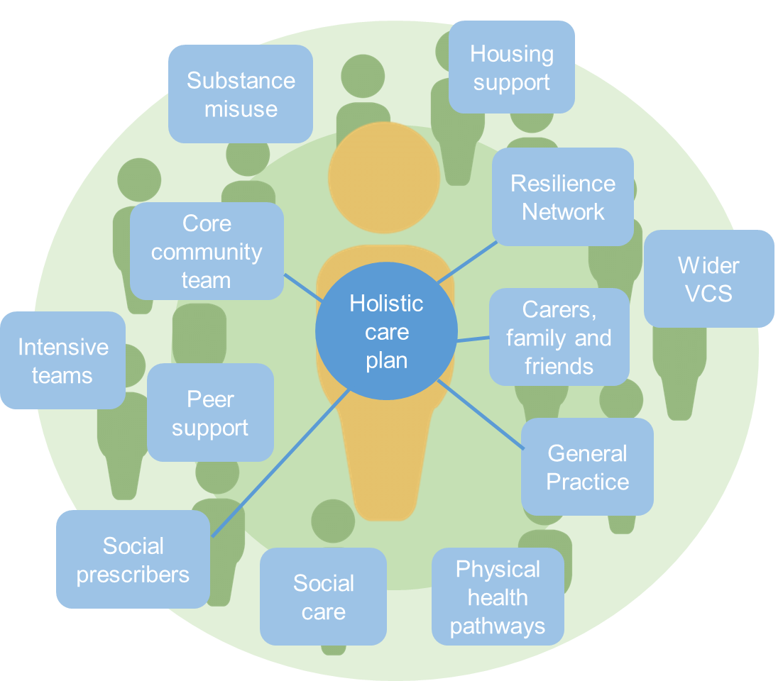
Developing multi-agency practice and a shared ethos
Using a single, holistic care plan that is owned by the individual, shared across boundaries and involves the right care and support from across the network
To cover:
Relationships
Accommodation
Mental health
Physical health
Practical support
Contact with services
Medication
Personal safety
Friendships
Leisure activities
Employment
and a system wide assessment and outcome tool, such as DIALOG

Slide 10
Emerging VCS prevention role in the model
Creating truly blended teams / offer
Organisational strengths approach
Coordination and maximisation of resources and simplified pathways
Single referral and no wrong door approach
Relational bridge between statutory services and wider community
Meeting a broad range of psychosocial needs
The importance of “holding” relationships
Co-production and development work with local communities & organisations to respond to local need and inform service development
Central role in making use of and reaching out to the whole community

Slide 11
Questions
Access to mental health services can be challenging – what would make a difference here?
How can services be more joined up across LA, NHS and community; physical and mental health; primary and secondary care
What are the gaps and opportunities for change in the new model?

